Slide 1
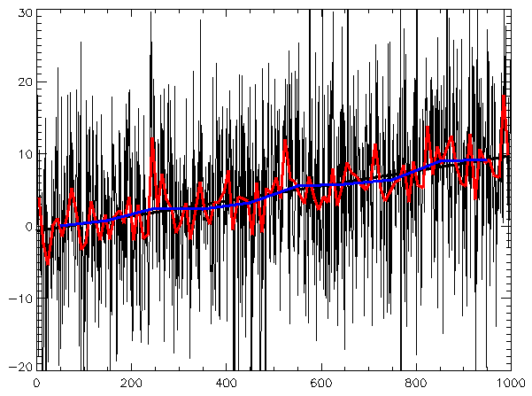
Time Series Analysis
Tides
Sunspots
Dow Jones Industrial Averages

Slide 2
four components:
Trend (T) – The long-term progression in the data (upward, downward, or stable).
Seasonality (S) – Regular patterns repeating over specific periods (e.g., monthly, quarterly).
Cyclic (C) – Fluctuations not of fixed period, usually tied to economic or business cycles.
Irregular/Random (R) – Random noise or residuals that cannot be explained by other components.

Slide 3
Time Series Analysis
Time
Secular Trend
Short time Oscillation
  Cyclical Fluctuations
  Seasonal fluctuations
  Irregular fluctuations

Slide 4
Models
Additive Model
Multiplicative Model

Slide 5
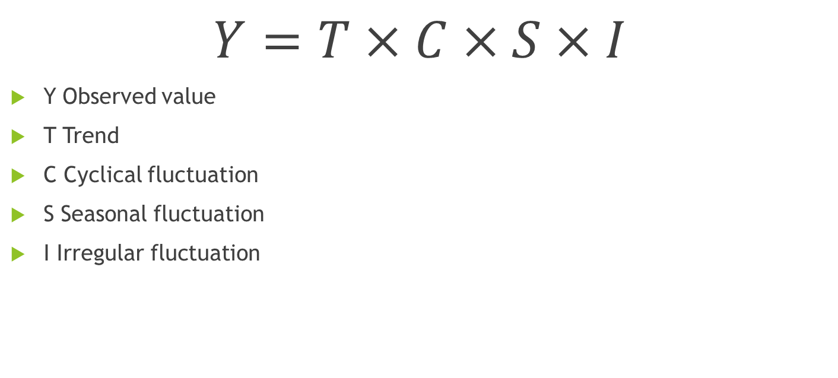
Multiplicative Model
$$Y=T×C×S×I$$
Y Observed value
T Trend
C Cyclical fluctuation
S Seasonal fluctuation
I Irregular fluctuation

Slide 6
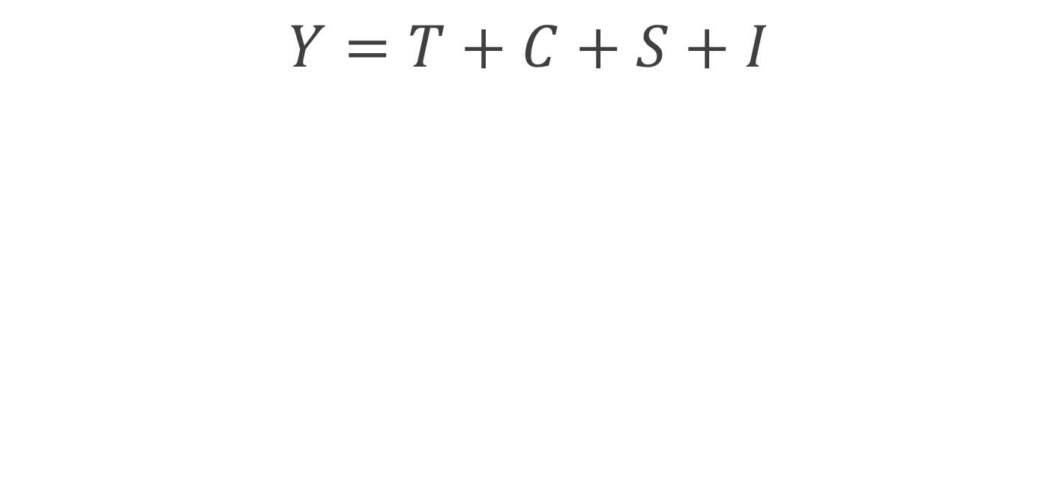
Additive Model
$$Y=T+C+S+I$$
Y Observed value
T Trend
C Cyclical fluctuation
S Seasonal fluctuation
I Irregular fluctuation

Slide 7
Choosing Between Additive and Multiplicative
Characteristic | Additive Model | Multiplicative Model
Seasonal Variation | Constant over time | Varies with trend
Suitable for | Linear trends and stable seasonality | Exponential growth or increasing seasonal effects
Example | Temperature | Sales revenue

Slide 8
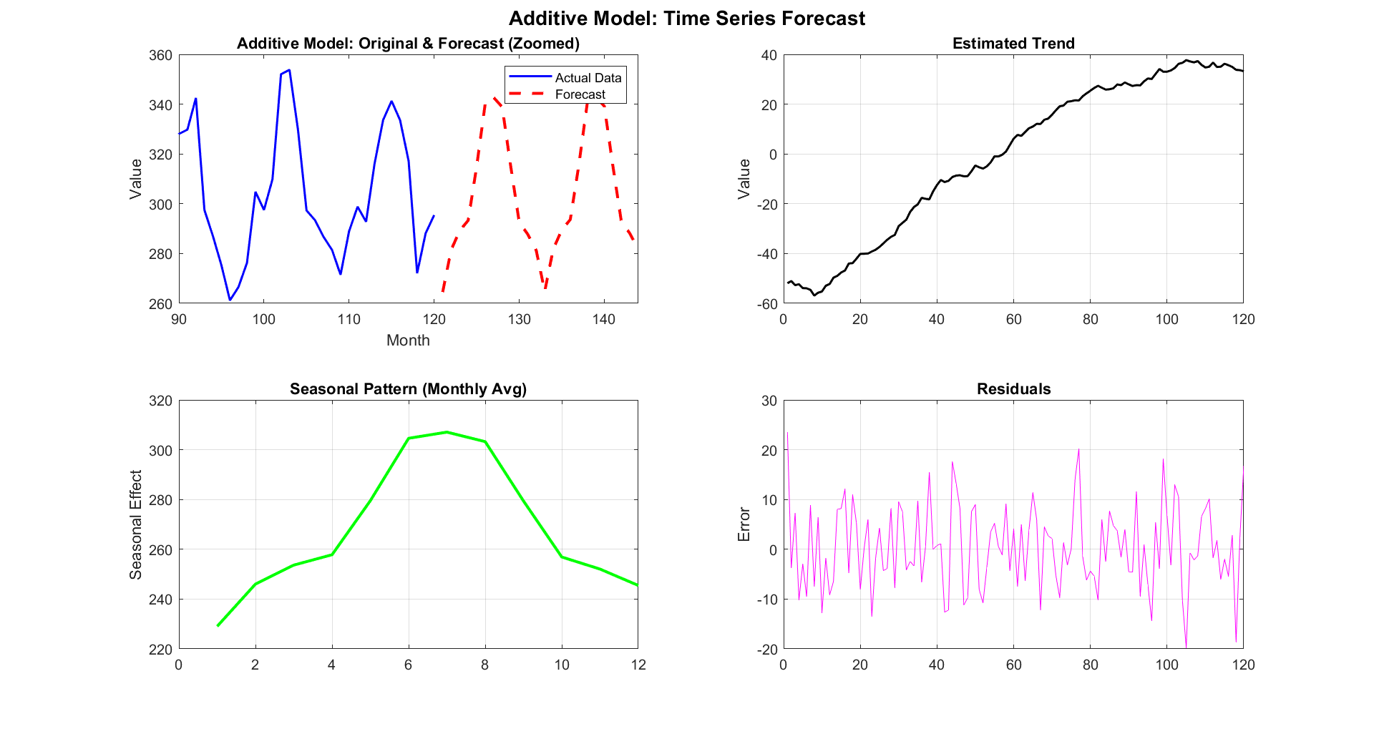

Slide 9
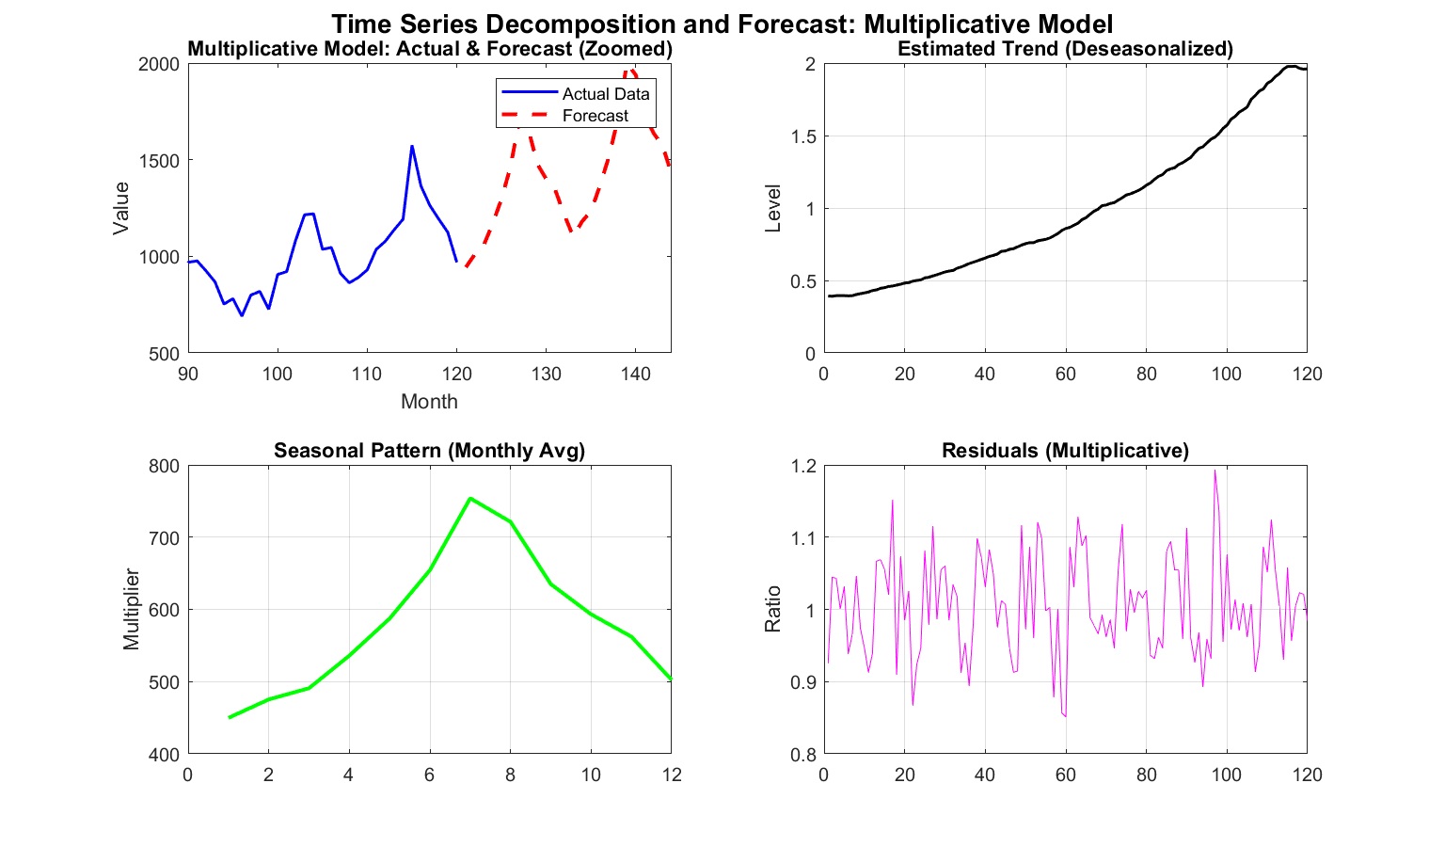

Slide 10
Methods of isolating trends
Free hand method
Semi average method
Method of moving averages
Method of least squares

Slide 11
t | Year | Quarter | Sales(1000s)
1 | Year 1 | 1 | 4.8
2 |  | 2 | 4.1
3 |  | 3 | 6
4 |  | 4 | 6.5
5 | Year 2 | 1 | 5.8
6 |  | 2 | 5.2
7 |  | 3 | 6.8
8 |  | 4 | 7.4
9 | Year 3 | 1 | 6
10 |  | 2 | 5.6
11 |  | 3 | 7.5
12 |  | 4 | 7.8
13 | Year 4 | 1 | 6.3
14 |  | 2 | 5.9
15 |  | 3 | 8
16 |  | 4 | 8.4

Slide 12
Time Series Analysis
Consider a data of number of disk access for 50 database quires.

Slide 13

Autoregressive Model
Predict the variable as a linear regression of the immediate past value
$$\hat{x}\left(t\right)=a_{0}+a_{1}x\left(t−1\right)$$

Slide 14

$$\hat{x}\left(t\right)=a_{0}+a_{1}x\left(t−1\right)+a_{2}x\left(t−2\right)+…+a_{p}x\left(t−p\right)$$
$$x\left(t\right)=a_{0}+a_{1}x\left(t−1\right)+a_{2}x\left(t−2\right)+…{+a}_{p}x\left(t−p\right)+e\left(t\right)$$

Slide 15
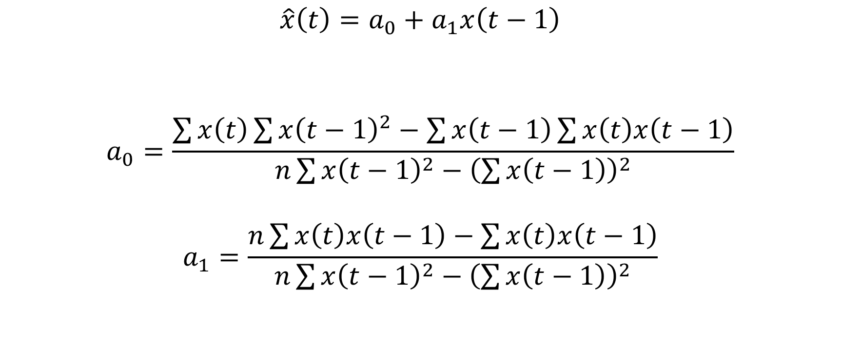
$$\hat{x}\left(t\right)=a_{0}+a_{1}x\left(t−1\right)$$
$$a_{0}=\frac{\sum{x\left(t\right)\sum{{x\left(t−1\right)}^{2}−\sum{x\left(t−1\right)\sum{x\left(t\right)x\left(t−1\right)}}}}}{n\sum{{x\left(t−1\right)}^{2}}−{\left(\sum{x\left(t−1\right)}\right)}^{2}}$$
$$a_{1}=\frac{n\sum{x\left(t\right)x\left(t−1\right)−\sum{x\left(t\right)x\left(t−1\right)}}}{n\sum{{x\left(t−1\right)}^{2}}−{\left(\sum{x\left(t−1\right)}\right)}^{2}}$$

Slide 16


$$p=2$$
$$x\left(t\right)=a_{0}+a_{1}x\left(t−1\right)+a_{2}x\left(t−2\right)+e\left(t\right)$$
$$SSE=\sum_{t=3}^{n}{{e\left(t\right)}^{2}}$$
$$SSE=\sum_{t=3}^{n}{{\left\{x\left(t\right)−\left(a_{0}+a_{1}x\left(t−1\right)+a_{2}x\left(t−2\right)\right)\right\}}^{2}}$$
$$\frac{dSSE}{da_{0}}=0 \frac{dSSE}{da_{1}}=0 \frac{dSSE}{da_{1}}=0$$

Slide 17

$$\sum_{t=3}^{n}{−2\left(a_{0}+a_{1}x\left(t−1\right)+a_{2}x\left(t−2\right)\right)=0}$$
$$\sum_{t=3}^{n}{−2x\left(t−1\right)\left(a_{0}+a_{1}x\left(t−1\right)+a_{2}x\left(t−2\right)\right)=0}$$
$$\sum_{t=3}^{n}{−2x\left(t−2\right)\left(a_{0}+a_{1}x\left(t−1\right)+a_{2}x\left(t−2\right)\right)=0}$$

Slide 18

$$\left[\begin{matrix}n−2 & \sum{x\left(t−1\right)} & \sum{x\left(t−2\right)} \\ \sum{x\left(t−1\right)} & \sum{{x\left(t−1\right)}^{2}} & \sum{x\left(t−1\right)x\left(t−2\right)} \\ \sum{x\left(t−2\right)} & \sum{x\left(t−1\right)x\left(t−2\right)} & \sum{{x\left(t−2\right)}^{2}}\end{matrix}\right]\left[\begin{matrix}a_{0} \\ a_{1} \\ a_{2}\end{matrix}\right]=\left[\begin{matrix}\sum{x\left(t\right)} \\ \sum{x\left(t\right)x\left(t−1\right)} \\ \sum{x\left(t\right)x\left(t−2\right)}\end{matrix}\right]$$
$$\left[\begin{matrix}a_{0} \\ a_{1} \\ a_{2}\end{matrix}\right]={\left[\begin{matrix}n−2 & \sum{x\left(t−1\right)} & \sum{x\left(t−2\right)} \\ \sum{x\left(t−1\right)} & \sum{{x\left(t−1\right)}^{2}} & \sum{x\left(t−1\right)x\left(t−2\right)} \\ \sum{x\left(t−2\right)} & \sum{x\left(t−1\right)x\left(t−2\right)} & \sum{{x\left(t−2\right)}^{2}}\end{matrix}\right]}^{−1}\left[\begin{matrix}\sum{x\left(t\right)} \\ \sum{x\left(t\right)x\left(t−1\right)} \\ \sum{x\left(t\right)x\left(t−2\right)}\end{matrix}\right]$$

