Slide 1
Self management
Developing yourself and taking responsibility
Integrity and ethical conduct
Personal Drive and resilience
Shows perseverance in the face of obstacles and bounces back from failure
Balancing work and life issues

Slide 2
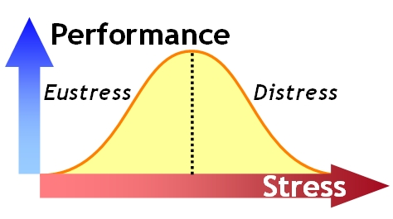
IS stress always bad?

Slide 3
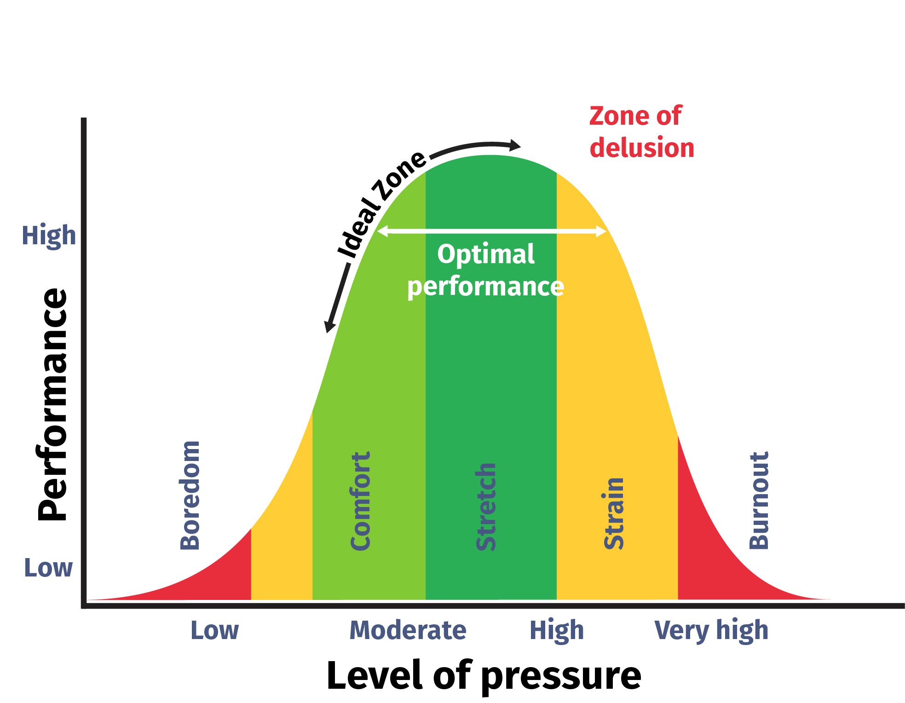
Exercise reduces stress
STRESS is State of increased arousal necessary for an organism to defend itself at a time of danger.

Slide 4
Stress management
What is Stress
Response to real or imagined threat or change
Some stress is Good Stress( Eustress) that is helpful and assists in drive achievement and success.
Stress = Pressure>Resources
SIGNS OF STRESS
Worry
Tense
Tired
Frightened
Elated
Anxious
Anger

Slide 5
stressors
Internal
Negative self talk
Mind traps
Personality traits
Pessimistic thinking
Self criticism
Over analysing
External
Physical Environment: Noise, Heat
Social Interaction:
Rudeness, Aggressiveness by others
Organizational
Rules
Deadlines
Major life events
Daily Hassles
Misplaced keys

Slide 6
Lifestyle Choice
Caffeine
LACK OF Sleep
Overloaded Schedule
Negative self thinking
Pessimistic thinking
Self Criticism
Over analysing

Slide 7
Most of the stress we experience is self-generated. How we perceive life, whether an event makes us feel threatened or stimulated, encouraged or discouraged, happy or sad- depends on how we perceived ourselves.

Slide 8
A B C
Awareness
Balance
Control

Slide 9
management
Be prepared for unexpected problems
Prioritize : Take control of your to do list by deciding whats really most important on your list.
Write down feeling of sadness , frustration or anger to get a clear perspective on your emotions.
Enjoy life simple pleasures like colorful flower, dancing , music , social outings etc.
Share your talents to better the life of others as well as your sense of well being.

Slide 10
Make a list
What MUST be done
What should be done
What would you LIKE to do
Cut out time wasting
Learn to drop unimportant activities
Say no or delegate

Slide 11
STRESS is very common
Use stress in a positive way
Limit, not eliminate stress
Use it to improve your performance

