Slide 1
Problems encountered by researchers in India

Slide 2

Lack of scientific training
Leap in the dark

Slide 3
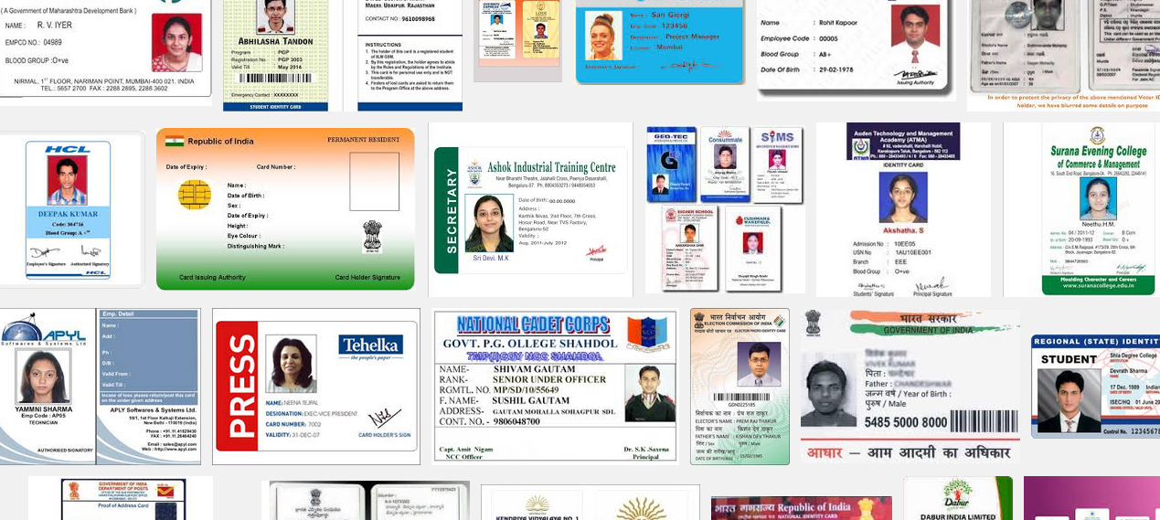
Insufficient Interaction
PAN, TIN, Licence, UID

Slide 4
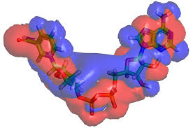
Research Studies Overlapping

Slide 5
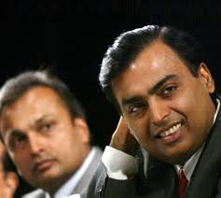
Code of Conduct( Lack of )
Rivalries

Slide 6

Lack of adequate and timely secretarial assistance

Slide 7
Library management and functioning
AD/BC
BG/AG

Slide 8

Timely availability of published data( Lack of)

