Slide 1
ANOVA
Analysis of Variance

Slide 2
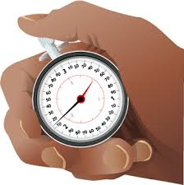
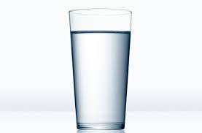
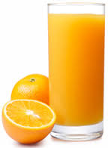

Lets say you want to find if the beverage that people drink affects their reaction time.

Slide 3
Null hypotheses: H₀
The mean of all three groups is the same.

Slide 4
Water | Juice | Coffee
29 | 28 | 25
30 | 29 | 28
31 | 27 | 29
31 | 30 | 27
29 | 29 | 29

Slide 5
Water | Juice | Coffee
10 | 11 | 12
12 | 14 | 13
18 | 19 | 17
24 | 23 | 25
36 | 38 | 37

Slide 6

Figure out how much of the total variance comes from: The variance between the groups The variance within the groups
$$F=\frac{between group}{within group}$$
The larger this number is , it is more likely the groups have different means. ( reject H₀)

Slide 7
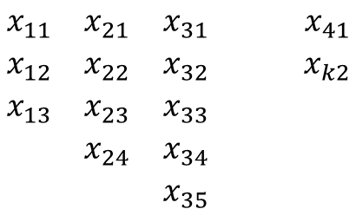
Data
$$\begin{matrix}x_{11} & x_{21} & x_{31} & & x_{41} \\ x_{12} & x_{22} & x_{32} & & x_{k2} \\ x_{13} & x_{23} & x_{33} & & \\ & x_{24} & x_{34} & & \\ & & x_{35} & & \end{matrix}$$

Slide 8
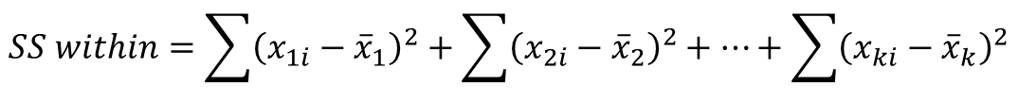
Sum of squares for variance between the samples
$$SS between=n_{1}{\left({\overline{x}}_{1}−\overset{̿}{x}\right)}^{2}+n_{2}{\left({\overline{x}}_{2}−\overset{̿}{x}\right)}^{2}+…+n_{k}{\left({\overline{x}}_{k}−\overset{̿}{x}\right)}^{2}$$
$$SS within=\sum{{\left(x_{1i}−{\overline{x}}_{1}\right)}^{2}}+\sum{{\left(x_{2i}−{\overline{x}}_{2}\right)}^{2}}+…+\sum{{\left(x_{ki}−{\overline{x}}_{k}\right)}^{2}}$$

Slide 9


Mean Square between samples
$$MS between=\frac{SS between}{k−1}$$
$$MS within=\frac{SS within}{n−k}$$

Slide 10
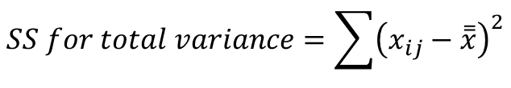


SS for total variance
$$SS for total variance=\sum{{\left(x_{ij}−\overset{̿}{x}\right)}^{2}}$$
$$SS for total variance=SS between+SS within$$
$$\left(n−1\right)=\left(k−1\right)+\left(n−k\right)$$
$$F−ratio=\frac{MS between}{MS within}$$

Slide 11
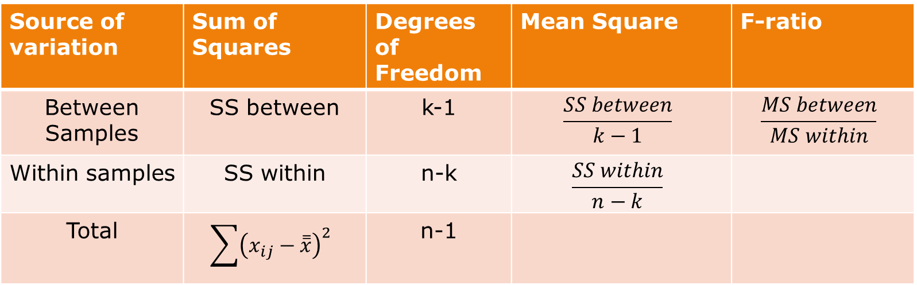
Table
Source of variation | Sum of Squares | Degrees of Freedom | Mean Square | F-ratio
Between Samples | SS between | k-1 | $$\frac{SS between}{k−1}$$ | $$\frac{MS between}{MS within}$$
Within samples | SS within | n-k | $$\frac{SS within}{n−k}$$
Total | $$\sum{{\left(x_{ij}−\overset{̿}{x}\right)}^{2}}$$ | n-1

Slide 12
Per acre production data for three varieties of wheat are , each grown on 4 plots are shown here. State if the variety differences are significant.
Plot of land | A | B | C
1 | 6 | 5 | 5
2 | 7 | 5 | 4
3 | 3 | 3 | 3
4 | 8 | 7 | 4

Slide 13
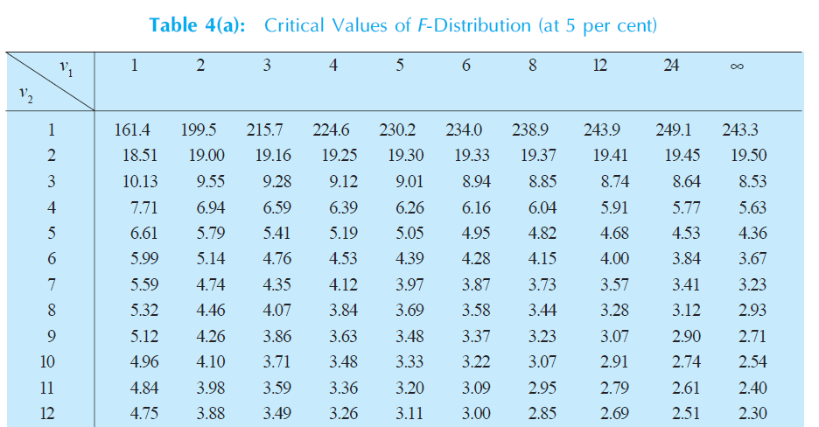

Slide 14

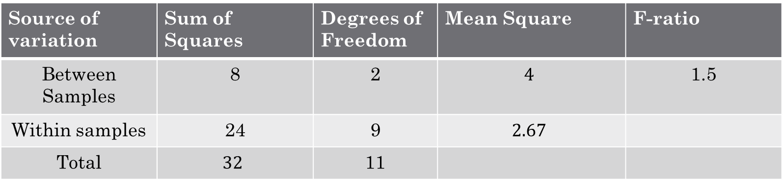
Results
The calculated F value 1.5 is less than the table value 4.26 at 5% level with d. f. being 2, 9. Hence analysis supports the null hypothesis of no difference of means.
Source of variation | Sum of Squares | Degrees of Freedom | Mean Square | F-ratio
Between Samples | 8 | 2 | $$4$$ | 1.5
Within samples | 24 | 9 | $$2.67$$
Total | $$32$$ | 11
$$F\left(2,9\right)=4.26$$

