Slide 1
Standards

Slide 2

ISO
It is composed of representative from various national standards organizations.
Headquarters in Geneva, Switzerland

Slide 3
It is granted the general consultative status by United Nations Economic and Social Council which allows ISO to participate in the work of the United Nations.
ISO began in 1926 as International Federation of National Standardizing Associations. It was suspended in 1942 during World War II. The new organisation ISO began operations in 1947.
It has 164 national members. Each member representing one country. Members meet annually at general assembly to discuss ISO strategic objectives.
Technical management board is responsible for over 250 technical committee is who developed the ISO standards sale of standards is one of the funding sources of the organisation.

Slide 4
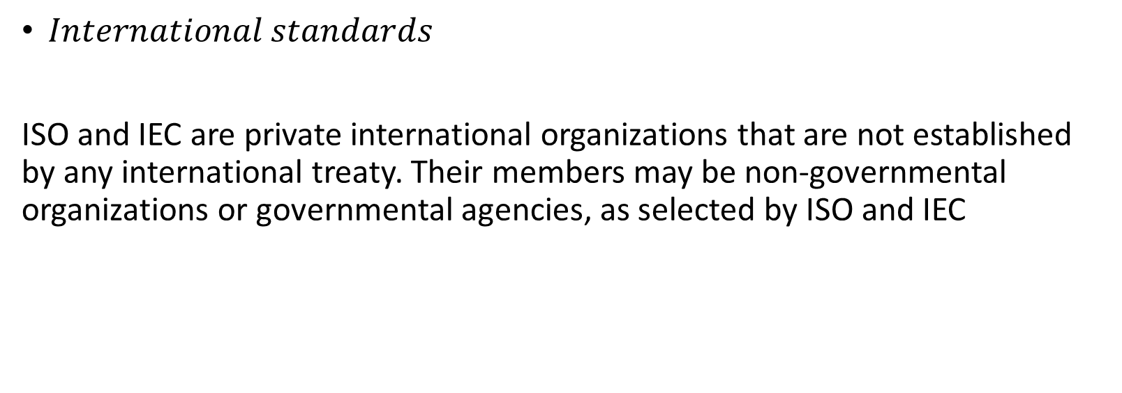
Standards
$International standards$
ISO and IEC are private international organizations that are not established by any international treaty. Their members may be non-governmental organizations or governmental agencies, as selected by ISO and IEC

Slide 5





ISO
BIS
India
ANSI
USA
BSI
UK
BSTI
Bangladesh

Slide 6
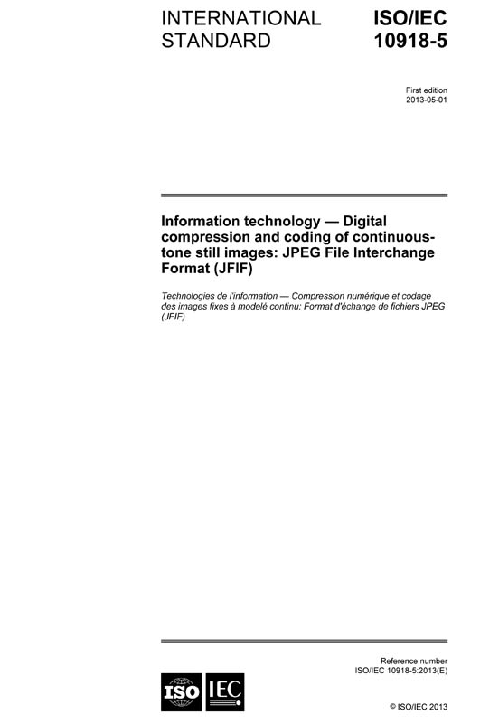
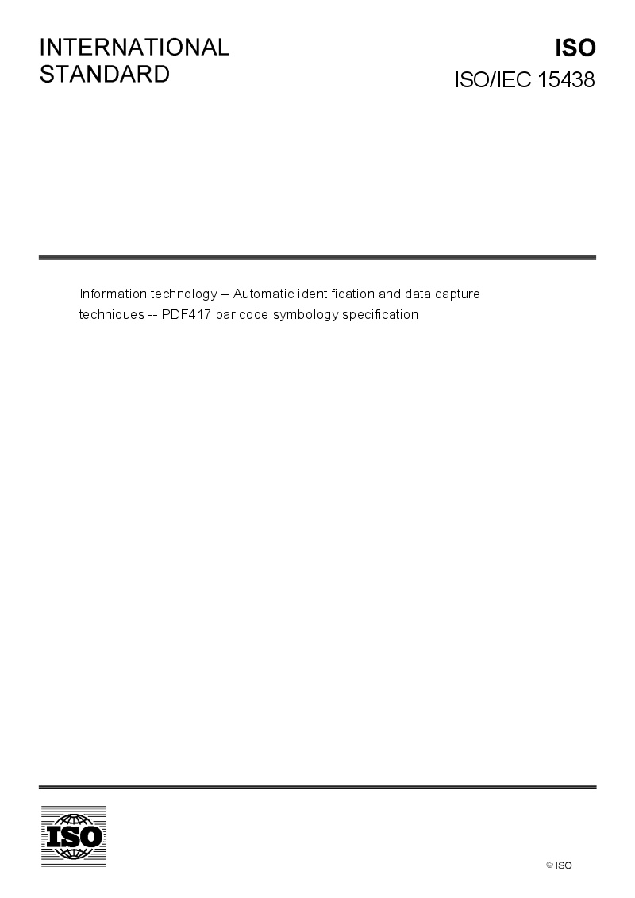


Slide 7
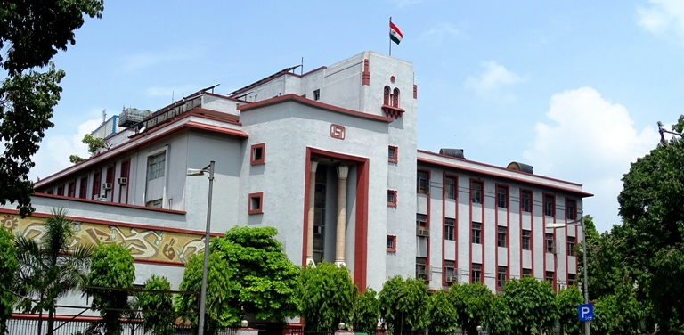
Bureau of Indian Standards
Manak Bhavan 9 Bahadur Shah Zafar Marg New Delhi 110002 India

Slide 8

ITU( International telecommunication Union)
The ITU is a treaty-based organization established as a permanent agency of the United Nations, in which governments are the primary members.
It is a specialized agency of the United Nations (UN) that is responsible for issues that concern information and communication technologies.
The ITU coordinates the shared global use of the radio spectrum, promotes international cooperation in assigning satellite orbits, works to improve telecommunication infrastructure.

Slide 9
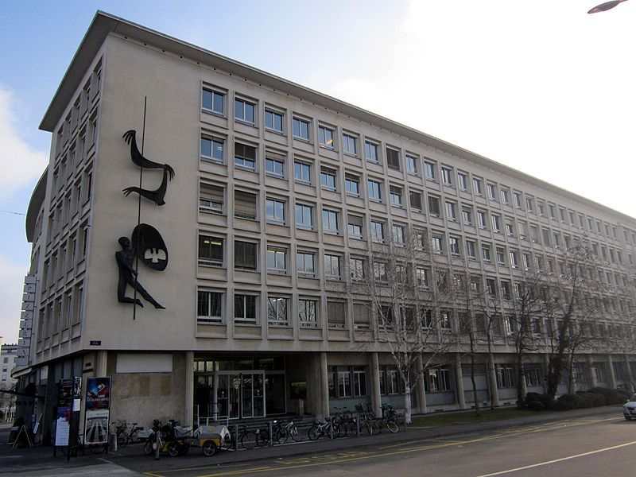

IEC
The International Electrotechnical Commission
It is a non-profit, non-governmental international standards organization that prepares and publishes International Standards for all electrical, electronic and related technologies.

Slide 10
The IEC was instrumental in developing and distributing standards for units of measurement, particularly Gauss, Hertz, and Weber. It also first proposed a system of standards, which ultimately became the SI, the International System of Units.
IEC standards have numbers in the range 60000–79999 and their titles take a form such as IEC 60417.

Slide 11







Independent international standards organizations
ASME, the ASTM International, the IEEE, the Internet Engineering Task Force (IETF), SAE International, TAPPI, the World Wide Web Consortium (W3C), and the Universal Postal Union (UPU)

Slide 12
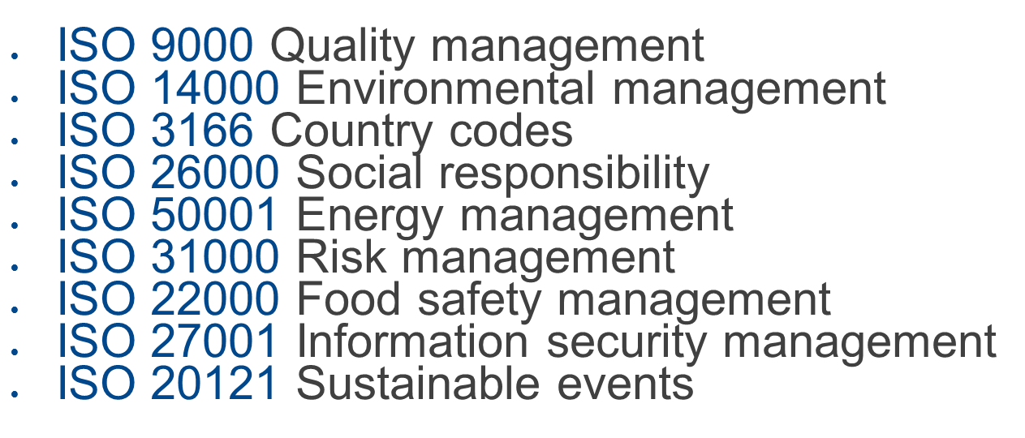
Popular standards

Slide 13
ISO/IEC 24734:2009
Abstract
ISO/IEC 24734:2009 provides a method for measuring the productivity of digital printing devices with various office applications and print job characteristics.
It is applicable to digital printing devices, including single function printing and multi-function devices, regardless of print technology (e.g. inkjet, laser). Devices can be equipped with a range of paper feed and finishing options either directly connected to the computer system or via a network.
It is intended to be used for black and white (B&W) as well as colour digital printing devices.
It allows for the comparison of the productivity of machines operating in various available modes (simplex, duplex, size of substrates, etc.) and office applications when the test system environment, operating modes, and job mix for each machine are held identical.
ISO/IEC 24734:2009 includes test files, test setup procedure, test runtime procedure, and the reporting requirements for the digital printing productivity measurements. It is not intended to be used for devices which are not able to print on a media size of A4/8.5”x11” or for devices which are not able to collate multiple copies of a print.

Slide 14
What do the following ISO standards stand for
ISO 9001
ISO 14001

Slide 15
Steps to Achieve ISO Certification
Internal Audit
Certification Audit: Schedule an audit with a certified external auditor or certification body.
The auditor evaluates the organization’s adherence to ISO standards.
Certification Issuance: The certification body issues an ISO certificate if compliant.
The certificate is valid for a specific period (usually 3 years).
Surveillance Audits: Conduct periodic surveillance audits (typically annually) to ensure continued compliance.
Role of Certification Bodies Accreditation: Certification bodies must be accredited by national or international accreditation organizations.

