Slide 1
Research Metrics

Slide 2
Impact factor
It is a measure reflecting the average number of citations to recent articles published in the journal.
It was designed by Eugene Garfield: The founder of Institute for Scientific information.
It is calculated yearly starting from 1975

Slide 3
Calculation
In any given year , the impact factor of a journal is the average number of citations received per paper published in that journal during the two preceding years.
A= number of times that all items published in that journal in 2006 and 2007 were cited by index publications during 2008.
B= total number of citable items published by that journal in 2006 and 2007
2008 impact factor = A/B

Slide 4
Citable items
Articles
Reviews
Proceedings
Notes
Excluded items:
  Editorials
  Letter to the editors

Slide 5
Journals that are indexed starting with a volume other than the first volume will not get an impact factor until they have been indexed for three years.

Slide 6
Factors affecting the impact factor
Irregular publications
Dependent on academic discipline
Taking mean of citation is unjustified as certain papers are actually not cited at all.
Editorial policies
  Review articles get cited more often
  Submission policy of ‘invitation only’ to invite exclusively senior scientists
  Declining to publish unlikely to be citied articles
  Spurious self citations

Slide 7
H- Index
It is an index that attempts to measure the productivity and impact of the published work of a scientist or scholar.
    Suggested by Jorge E Hirsch
Definition
  A scholar has index h if h of his /her N papers have at least h citations each , and the other N –h papers have no more than h citations each.

Slide 8
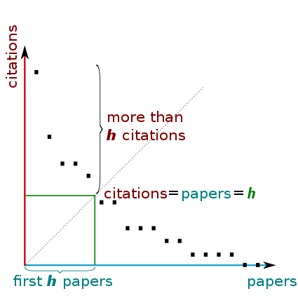

Slide 9
Advantages
Total number of papers do not disproportionally affect the count.

Slide 10
Disadvantages
Does not account for number of authors of the paper
Give the book the same count as articles
It is a natural number which reduces the discriminatory power

Slide 11
www.sciencegateway.org/
Rank
High Impact Factor Journals

