Slide 1
Research Design

Slide 2
Research DESIGN
Decisions regarding what, where, when, how much
A research design
  The arrangement of conditions for collection and analysis of data in a manner that aims to combine relevance to the research purpose with economy in procedure

Slide 3
The designing decisions happen to be in respect of:
  What is the study about?
  Why is the study being made?
  Where will the study be carried out?
  What type of data is required?
  Where can the required data be found?
  What periods of time will the study include?
  What will be the sample design?
  What techniques of data collection will be used?
  How will the data be analyzed?
  In what style will the report be prepared?

Slide 4
Control
  A critical characteristic of a good research design is to minimize the influence or effect of extraneous variable(s).
Confounded relationship
  When the dependent variable is not free from the influence of extraneous variable(s)
  The relationship between the dependent and independent variables is said to be confounded/confused by an extraneous variable(s).

Slide 5
experiment designs
  (a) Informal experimental designs
    Before-and-after without control design.
    After-only with control design.
    Before-and-after with control design.
  (b) Formal experimental designs
    Completely randomized design (C.R. Design).
    Randomized block design (R.B. Design).
    Latin square design (L.S. Design).
    Factorial designs.

Slide 6
Before-and-after without control design
  A single test group or area is selected, and the dependent variable is measured
  No Pre-test , control group , or randomization
  Example: A company introduces a new employee training program and evaluates productivity afterwards

Slide 7
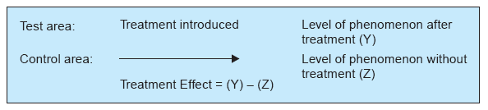
After-only with control Design
Also known as Static –Group Comparison
  Two groups or areas (test area and control area) are selected and the treatment is introduced into the test area only
Example: Comparing customer satisfaction in two stores-one with a new loyalty program and one without it.

Slide 8
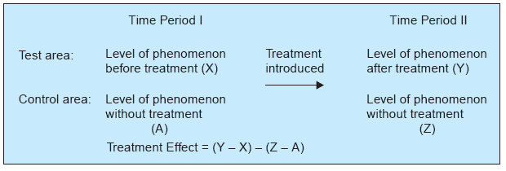
Before-and-after with control design

Slide 9
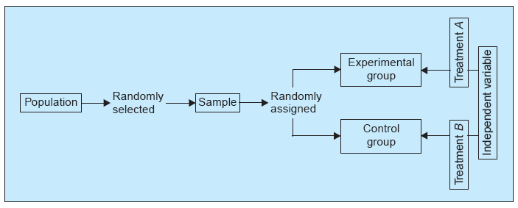
Completely randomized design (C.R. design)
In practice, the randomization is typically performed by a computer program. However, the randomization can also be generated from random number tables or by some physical mechanism (e.g., drawing the slips of paper).
Example( sleeping pill test), the participants were randomly assigned to either the treatment group or the placebo group, eliminating potential bias and creating two comparable groups

Slide 10
Randomized Block Design
Units are grouped into blocks based on a relevant characteristic. For example, if studying the effects of a new fertilizer on plant growth, the different blocks could represent different soil types.
Within each block, the different treatments or conditions are randomly assigned to the experimental units.
Each treatment appears once within each block.
Random assignment helps mitigate the influence of any confounding variables within each block.

Slide 11
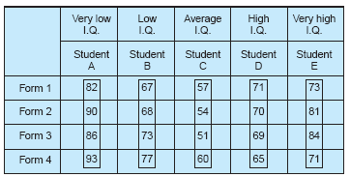
Example
Suppose four different forms of a test were given to five students selected from five different IQ blocks.
Question
What is the extraneous variable/factor here? How is it nullified?

Slide 12
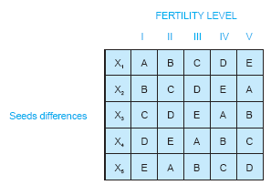
Latin square design (L.S. design)
  To control two sources of variables simultaneously.
  Treatment appears exactly once in each row and column of a grid, minimizing the potential confounding effects.
  The order in which the factors are presented could influence the results; a Latin Square design can help control for this order effect.
  Five types of fertilizers (A, B, C, D, and E) are to be studied on five different seeds and five different fertility levels

Slide 13
Factorial Research Design
Multiple variables and Interactions
Examines the effect of two ore more independent variables simultaneously.
Independent Variable1:
Teaching Method
Independent Variable 2:
Study Environment
Level 1: Traditional Lecture
Level 2: Interactive Group Discussion
Level 1: Quiet Library
Level 2: Noisy Coffee Shop
Example: Studying how different combinations of diet and exercise affect weight loss.

Slide 14
Example:
Does the punishment depend upon the appearance of a person and type of crime or LAW should be same for ALL
In the following two slides You need to decide what should be length of the sentence ( in Months) If these persons have commmited a (a) Swindle (B) Robbery

Slide 15
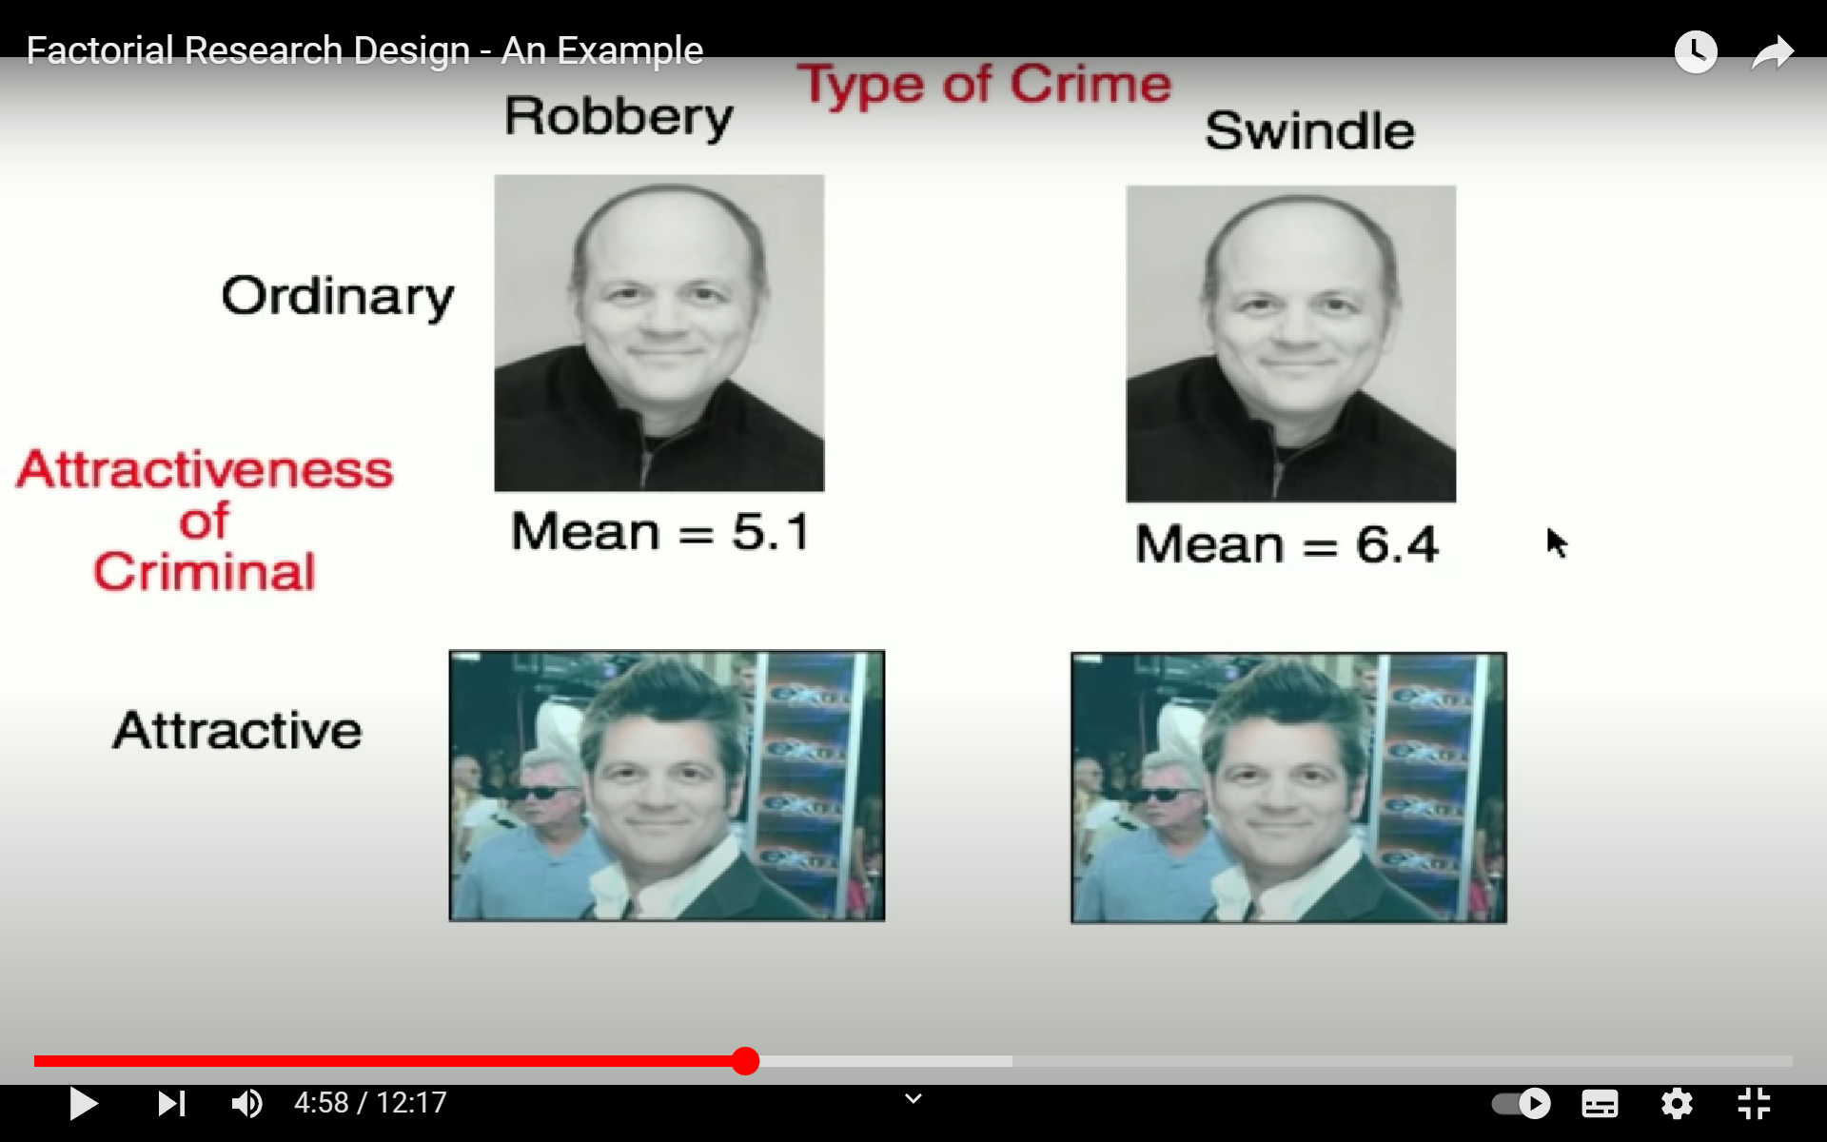

Slide 17
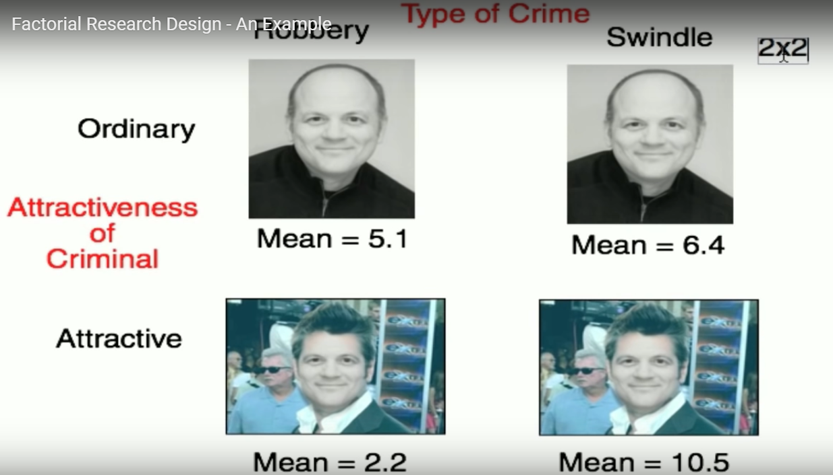

Slide 18
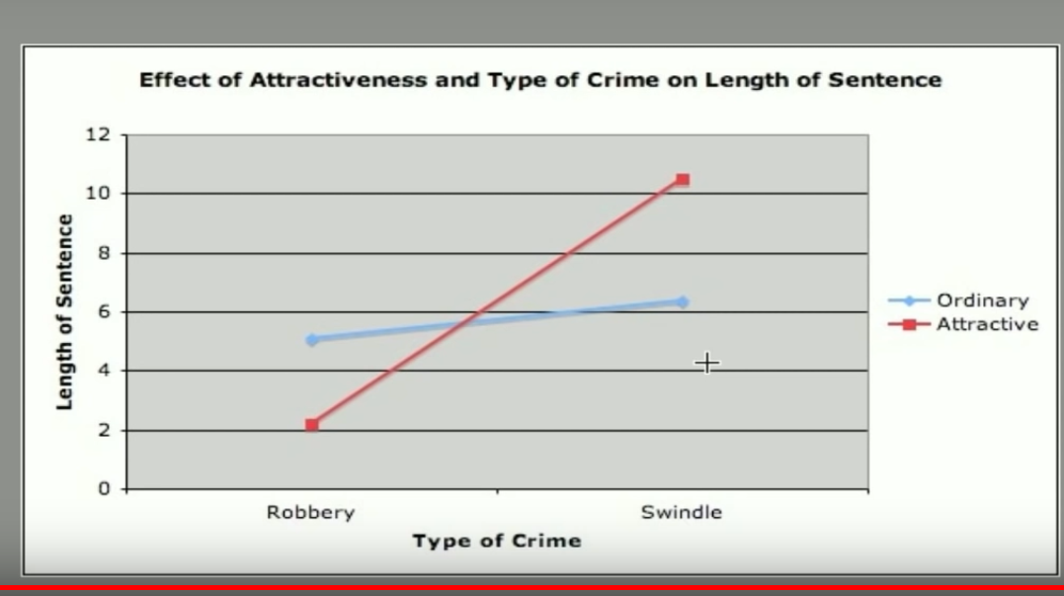

Slide 19
Longitudinal and Cross-sectional studies
Longitudinal studies
collection and analysis of data from the same subjects or participants over an extended period
Health and aging study
Cross Sectional Study
collecting data from a population or a sample at a single point in time.
Example: Examining the Relationship Between Physical Activity and Mental Well-being Among College Students
  Cohort Studies: In cohort studies, different groups (cohorts) of participants are studied.

