Slide 1
Research Methodology
Lecture 5

Slide 2
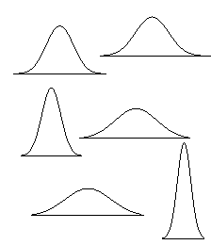
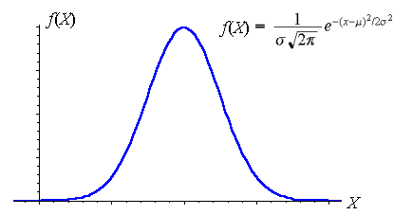
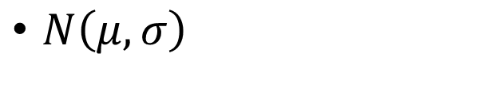
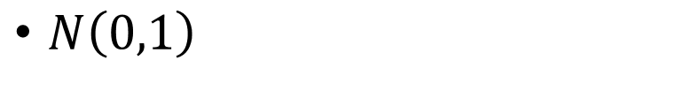
Normal Distribution
$N\left(μ,σ\right)$
Standard Normal Distribution
$N\left(0,1\right)$

Slide 3
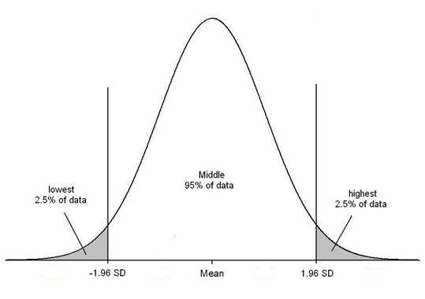
90%, 95%, 99%

Slide 4

Standard normal distribution
$f\left(x\right)=\frac{1}{σ\sqrt{2π}}e^{−\frac{1}{2σ^{2}}{\left(x−μ\right)}^{2}}$
$z=\frac{x−μ}{σ/\sqrt{n}}$
$t=\frac{x−μ}{s_{1}/\sqrt{n}}$
$s_{1}=\frac{\sum{{\left(x_{i}−\overline{x}\right)}^{2}}}{n−1}$

Slide 5
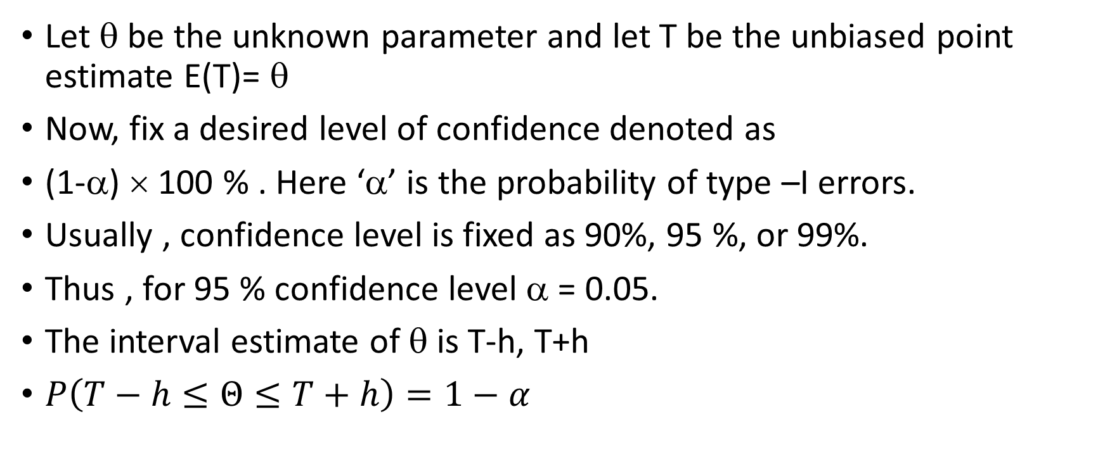
Interval Estimation
Let θ be the unknown parameter and let T be the unbiased point estimate E(T)= θ
Now, fix a desired level of confidence denoted as
(1-α) × 100 % . Here ‘α’ is the probability of type –I errors.
Usually , confidence level is fixed as 90%, 95 %, or 99%.
Thus , for 95 % confidence level α = 0.05.
The interval estimate of θ is T-h, T+h
$P\left(T−h≤Θ≤T+h\right)=1−α$

Slide 6
Critical Values for some commonly used levels
Confidence Level | Confidence Coefficient | alpha | Critical Value
80% | 0.8 | 0.2 | 1.28
90% | 0.9 | 0.1 | 1.645
95% | 0.95 | 0.05 | 1.96
98% | 0.98 | 0.02 | 2.33
99% | 0.99 | 0.01 | 2.58

Slide 7
Example 9.1 ( Kothari)
A sample of 11 circuits from a large normal population has a mean resistance of 2.20 ohms. We know from past testing that the population standard deviation is 0.35 ohms. Determine a 95% confidence interval for the true mean resistance of the population.
Caution: Even though n < 11 , but population’s standard deviation is given.

Slide 8
Example 9.2 ( Kothari)
A sample of 11 circuits from a large normal population has a mean resistance of 2.20 ohms. Population standard deviation is not known. Sample standard deviation ( s1 ) is 0.35 ohms. Determine a 95% confidence interval for the true mean resistance of the population.

Slide 9
Example 9.9 ( Kothari)
From a random sample of 36 New Delhi civil service personnel, the mean age and the sample standard deviation were found to be 40 years and 4.5 years respectively. Construct a 95% confidence interval for the mean age of civil servants in New Delhi.

Slide 10
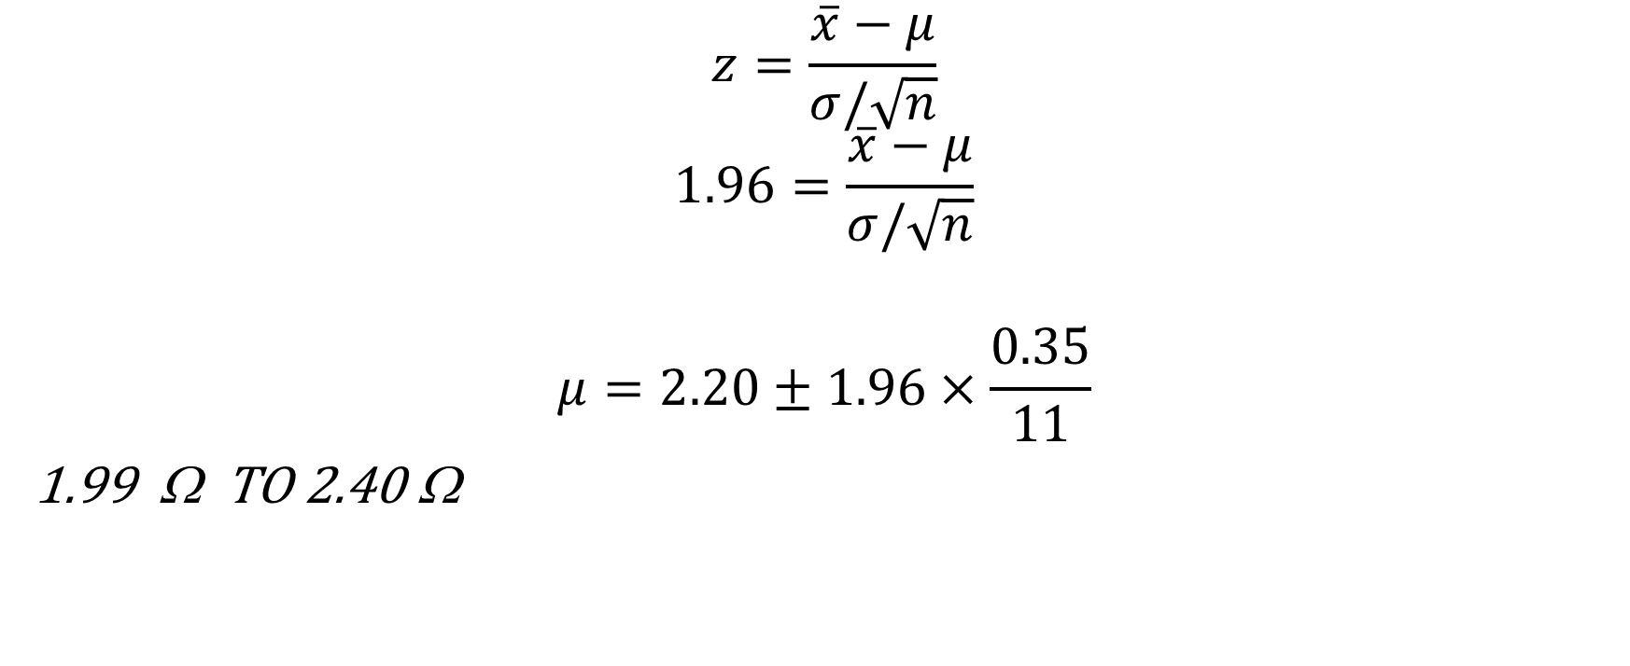
$$z=\frac{\overline{x}−μ}{σ/\sqrt{n}}$$
$$1.96=\frac{\overline{x}−μ}{σ/\sqrt{n}}$$
$$μ=2.20±1.96×\frac{0.35}{11}$$
1.99 Ω TO 2.40 Ω

Slide 11




Formulae
$$z=\frac{\overline{x}−μ}{σ/\sqrt{n}}$$
$$s^{2}=\frac{1}{n−1}\sum_{i=1}^{n}{{\left(x_{i}−\overline{x}\right)}^{2}}$$
$$z=\frac{\overline{x}−μ}{s/\sqrt{n}}$$
$$z=\frac{\left({\overline{x}}_{1}−{\overline{x}}_{2}\right)−\left(μ_{1}−μ_{2}\right)}{\sqrt{\frac{σ_{1}^{2}}{n_{1}}+\frac{σ_{2}^{2}}{n_{2}}}}$$

Slide 12


z-tests require one of two conditions: either the population is normally distributed with a known variance, or the sample size is large.
For small n
$$t=\frac{\overline{x}−μ}{s/\sqrt{n}}$$
$$t=\frac{\left({\overline{x}}_{1}−{\overline{x}}_{2}\right)−\left(μ_{1}−μ_{2}\right)}{\sqrt{\left(\frac{\left(n_{1}−1\right)s_{1}^{2}+\left(n_{2}−1\right)s_{2}^{2}}{n_{1}+n_{2}−2}\right)}\sqrt{\frac{1}{n_{1}}+\frac{1}{n_{2}}}}$$

Slide 13
A professor is marking the test out of 60. Here are the results:
20 15 26 32 18 28 35 14 26 22 17
Most of the students did not get 30 out of 60 and most will fail. The test must have been really hard. The professor decides to standardize and detain only the students who are 1 standard deviation below the mean. Which of the students will be detained?

Slide 14
Score | Standard Score
20 | -0.45
15 | -1.21 (Detain)
26 | 0.45
32 | 1.36
18 | -0.76
28 | 0.76
35 | 1.82
14 | -1.36( Detain)
26 | 0.45
22 | -0.15
17 | -0.91
m = 23, σ =6.6

Slide 15
A professor is marking the test out of 60. Here are the results:
20 15 26 32 18 28 35 14 26 22 17
Most of the students did not get 30 out of 60 and most will fail. The test must have been really hard. The professor decides to standardize and detain only the students who are 1 standard deviation below the mean. Which of the students will be detained?

Slide 16
Score | Standard Score
20 | -0.45
15 | -1.21 (Detain)
26 | 0.45
32 | 1.36
18 | -0.76
28 | 0.76
35 | 1.82
14 | -1.36( Detain)
26 | 0.45
22 | -0.15
17 | -0.91
m = 23, σ =6.6

Slide 17
Example 9.1
Mean resistance = 2.20 Ω for 11 resistances. Given σ = 0.35 Ω (of population). Determine 95% confidence interval for true mean resistance.

Slide 18
$$z=\frac{\overline{x}−μ}{σ/\sqrt{n}}$$
$$1.96=\frac{\overline{x}−μ}{σ/\sqrt{n}}$$
$$μ=2.20±1.96×\frac{0.35}{11}$$
1.99 Ω TO 2.40 Ω

Slide 19
Example 9.11 ( Kothari)
The foreman of a company has estimated the average quantity of iron ore extracted to be 36.8 tons per shift and the sample standard deviation to be 2.8 tons per shift, based upon random selection of 4 shifts. Construct a 90 % confidence interval around this estimate.

Slide 20
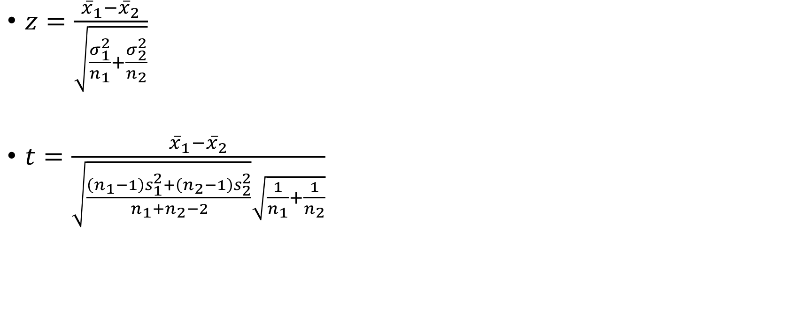
Testing of Hypothesis
$z=\frac{{\overline{x}}_{1}−{\overline{x}}_{2}}{\sqrt{\frac{σ_{1}^{2}}{n_{1}}+\frac{σ_{2}^{2}}{n_{2}}}}$
$t=\frac{{\overline{x}}_{1}−{\overline{x}}_{2}}{\sqrt{\frac{\left(n_{1}−1\right)s_{1}^{2}+\left(n_{2}−1\right)s_{2}^{2}}{{n_{1}+n}_{2}−2}}\sqrt{\frac{1}{n_{1}}+\frac{1}{n_{2}}}}$

Slide 21
Example 10.5 ( Kothari)
In a survey of buying habits 400 women shoppers are chosen at random in a super market Á’. Their average weekly food expenditure is Rs 250 with a standard deviation of Rs 40. For 400 women shoppers choses at random in some other super market ‘B’, the average weekly food expenditure is Rs 220 with a standard deviation of Rs 55. Do these two populations have similar shopping habits? Is the average weekly food expenditure of two populations of shoppers equal. Test at 5% level of significance.

Slide 22
Example 10.6( Kothari)
You are a finance analyst for a brokerage firm. Is there a difference in dividends by NYSE and NASDAQ ? You collet the following data:
Assuming both populations are approximately normal with equal variances, is there a difference in average yield.
Number of stocks | 21 | 25
Sample Mean | 3.27 | 2.53
Sample Std. Deviation | 1.30 | 1.16

Slide 23
A professor is marking the test out of 60. Here are the results:
20 15 26 32 18 28 35 14 26 22 17
Most of the students did not get 30 out of 60 and most will fail. The test must have been really hard. The professor decides to standardize and detain only the students who are 1 standard deviation below the mean. Which of the students will be detained?

Slide 24
Example 9.1
Mean resistance = 2.20 Ω for 11 resistances. Given σ = 0.35 Ω (of population). Determine 95% confidence interval for true mean resistance.

Slide 25
$$z=\frac{\overline{x}−μ}{σ/\sqrt{n}}$$
$$1.96=\frac{\overline{x}−μ}{σ/\sqrt{n}}$$
$$μ=2.20±1.96×\frac{0.35}{11}$$
1.99 Ω TO 2.40 Ω

Slide 26
Score | Standard Score
20 | -0.45
15 | -1.21 (Detain)
26 | 0.45
32 | 1.36
18 | -0.76
28 | 0.76
35 | 1.82
14 | -1.36( Detain)
26 | 0.45
22 | -0.15
17 | -0.91
m = 23, σ =6.6

Slide 27
Z-Test

Slide 28
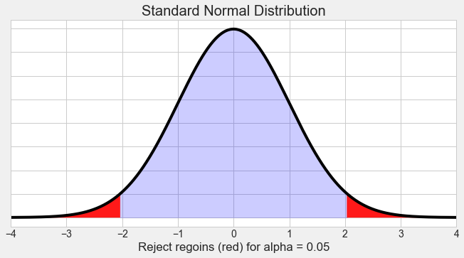
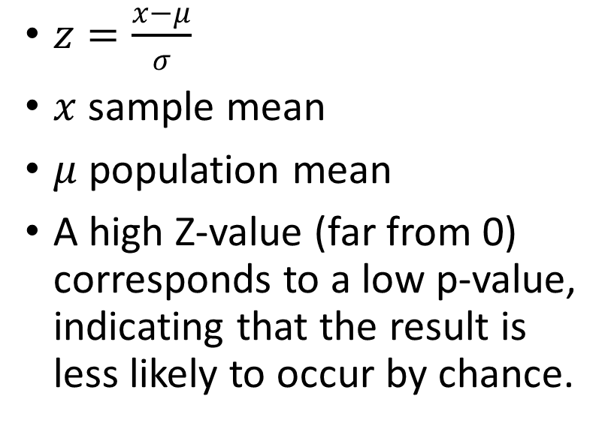
Z -test
$z=\frac{x−μ}{σ}$
$x$ sample mean
$μ$ population mean
A high Z-value (far from 0) corresponds to a low p-value, indicating that the result is less likely to occur by chance.

Slide 29
Example 1: Z-value of 1.96
Hypothesis: The mean score of a group of students is significantly different from the national average.
Z-value: 1.96
P-value: In a two-tailed test, this corresponds to a p-value of 0.05 (5% significance level).
Interpretation: If the p-value is 0.05, there is a 5% chance of observing a result at least as extreme as this one if the null hypothesis is true. If your significance level (alpha) is 0.05, you would reject the null hypothesis and conclude the difference is statistically significant.

Slide 30
Example 2: Z-value of 2.58
Hypothesis: The mean height of a sample is significantly different from the average height of the population.
Z-value: 2.58
P-value: In a two-tailed test, this corresponds to a p-value of 0.01.
Interpretation: With a p-value of 0.01, there is only a 1% chance of observing a result as extreme as this one if the null hypothesis is true. This is strong evidence against the null hypothesis. You would reject the null hypothesis at a 1% significance level.

Slide 31
Example 3: Z-value of 1.28
Hypothesis: The average number of hours worked by employees in a company is significantly higher than the national average.
Z-value: 1.28
P-value: In a one-tailed test, this corresponds to a p-value of 0.10.
Interpretation: A p-value of 0.10 means there is a 10% chance of observing this result if the null hypothesis is true. If you set your significance level (alpha) at 0.05, this p-value would be too high to reject the null hypothesis, meaning you don’t have enough evidence to conclude the average hours worked is significantly higher.

Slide 32
Example 4: Z-value of 0
Hypothesis: A medication has an effect on blood pressure compared to a placebo.
Z-value: 0
P-value: A Z-value of 0 corresponds to a p-value of 1.0.
Interpretation: This means the sample mean is exactly equal to the population mean. There is no evidence against the null hypothesis, so you would fail to reject the null hypothesis.

Slide 33
Example 5: Z-value of -2.33
Hypothesis: The mean weight loss in a sample is less than the mean weight loss in the population.
Z-value: -2.33
P-value: In a one-tailed test, this corresponds to a p-value of 0.01.
Interpretation: A p-value of 0.01 suggests there is only a 1% chance of observing a result as extreme as this under the null hypothesis. If your significance level is 0.05, you would reject the null hypothesis.

Slide 34
t-test

Slide 35
Example 9.1 ( Kothari)
A sample of 11 circuits from a large normal population has a mean resistance of 2.20 ohms. We know from past testing that the population standard deviation is 0.35 ohms. Determine a 95% confidence interval for the true mean resistance of the population.
Caution: Even though n < 11 , but population’s standard deviation is given.

Slide 36
Example 9.2 ( Kothari)
A sample of 11 circuits from a large normal population has a mean resistance of 2.20 ohms. Population standard deviation is not known. Sample standard deviation ( s1 ) is 0.35 ohms. Determine a 95% confidence interval for the true mean resistance of the population.

Slide 37
Example 9.9 ( Kothari)
From a random sample of 36 New Delhi civil service personnel, the mean age and the sample standard deviation were found to be 40 years and 4.5 years respectively. Construct a 95% confidence interval for the mean age of civil servants in New Delhi.

Slide 38
Example 9.11 ( Kothari)
The foreman of a company has estimated the average quantity of iron ore extracted to be 36.8 tons per shift and the sample standard deviation to be 2.8 tons per shift, based upon random selection of 4 shifts. Construct a 90 % confidence interval around this estimate.

Slide 39
Testing of Hypothesis
$z=\frac{{\overline{x}}_{1}−{\overline{x}}_{2}}{\sqrt{\frac{σ_{1}^{2}}{n_{1}}+\frac{σ_{2}^{2}}{n_{2}}}}$
$t=\frac{{\overline{x}}_{1}−{\overline{x}}_{2}}{\sqrt{\frac{\left(n_{1}−1\right)s_{1}^{2}+\left(n_{2}−1\right)s_{2}^{2}}{{n_{1}+n}_{2}−2}}\sqrt{\frac{1}{n_{1}}+\frac{1}{n_{2}}}}$

Slide 40
Example 10.5 ( Kothari)
In a survey of buying habits 400 women shoppers are chosen at random in a super market Á’. Their average weekly food expenditure is Rs 250 with a standard deviation of Rs 40. For 400 women shoppers choses at random in some other super market ‘B’, the average weekly food expenditure is Rs 220 with a standard deviation of Rs 55. Do these two populations have similar shopping habits? Is the average weekly food expenditure of two populations of shoppers equal. Test at 5% level of significance.

Slide 41
Example 10.6( Kothari)
You are a finance analyst for a brokerage firm. Is there a difference in dividends by NYSE and NASDAQ ? You collet the following data:
Assuming both populations are approximately normal with equal variances, is there a difference in average yield.
Number of stocks | 21 | 25
Sample Mean | 3.27 | 2.53
Sample Std. Deviation | 1.30 | 1.16

Slide 42
Example: Suppose that a researcher wished to learn if a particular chemical is toxic to a certain species of beetle. She believes that the chemical might interfere with the beetle’s reproduction. She obtained beetles and divided them into two groups. She then fed one group of beetles with the chemical and used the second group as a control. After 2 weeks, she counted the number of eggs produced by each beetle in each group. The mean egg count for each group of beetles is below.
Group 1 Group 2
fed chemical not fed chemical (control)
33 35
31 42
34 43
38 41
32
28

Slide 43
Conclusion
The researcher concludes that the mean of group 1 is significantly less than the mean for group 2.

