Slide 1
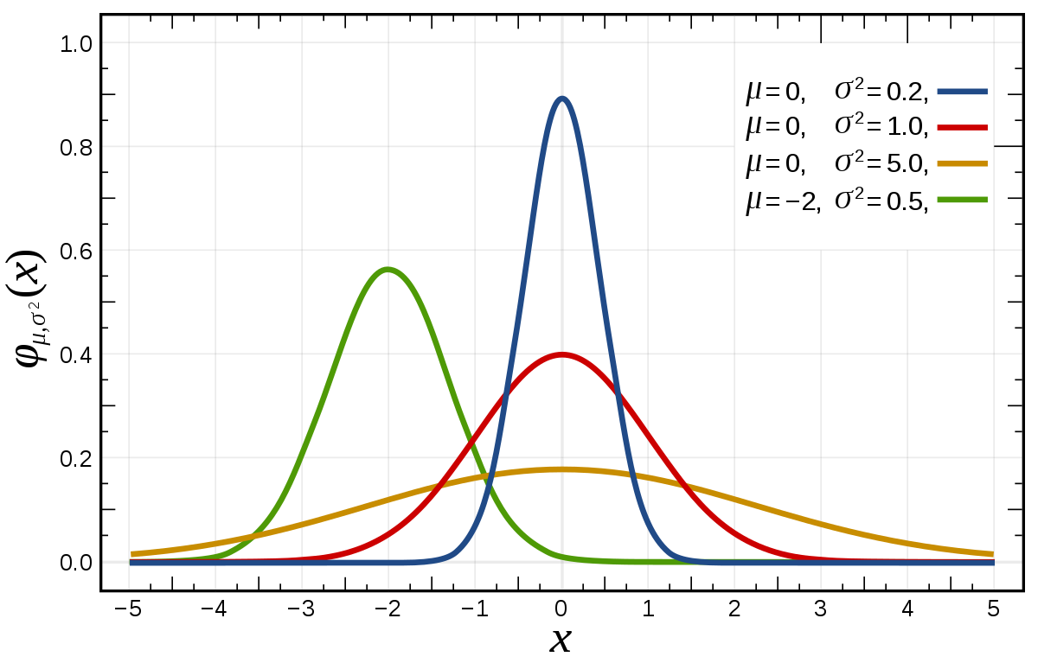
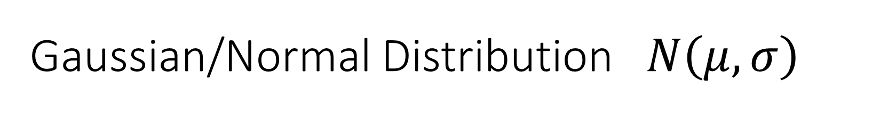
Gaussian/Normal Distribution $N\left(μ,σ\right)$
Standard Normal Distribution N(0,1)

Slide 2
Interactive website session
https://academo.org/demos/gaussian-distribution/

Slide 3

Standard normal distribution
$$f\left(x\right)=\frac{1}{σ\sqrt{2π}}e^{−\frac{1}{2σ^{2}}{\left(x−μ\right)}^{2}}$$

Slide 4

$$Z=2.7539$$
2.7539
1.645
α=0.05

Slide 5
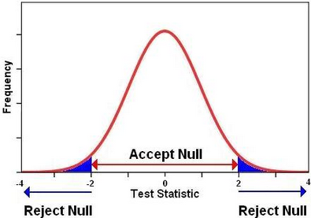


Null Hypothesis
Alternate Hypothesis
$$H_{0 }: μ=μ_{0}$$
$$H_{1 }: μ≠μ_{0}$$

Slide 6
Gaussian Distribution
The gravitational acceleration on Earth is constant at all locations.
The pH level of pure water remains 7 under standard conditions.
The heart rate of a resting adult human remains stable over time.
The body temperature of a healthy human remains at 37°C.

