Slide 1

Variable
Dinesh Ganotra
Notes:
NOTE:
To change the image on this slide, select the picture and delete it. Then click the Pictures icon in the placeholder to insert your own image.

Slide 2
Variables ( Measurement Scales)
Nominal
  Assignment of numbers to basketball players in order to identify them.
  Such numbers cannot be considered in order of no consequence; the numbers are just convenient labels and have no quantitative value.
Ordinal
  Scale places events in order but real difference between adjacent ranks may not be equal
  Person A ‘s position in class is 10 and B’s is 40. It cannot be said that A is four times as good as B.
Interval
  It can have arbitrary zero but not absolute zero or origin. Incorporates equality of interval
    Farenheit scale
Ratio
  Have absolute zero or true zero of measurement
    Minor traffic violation, typing errors

Slide 3
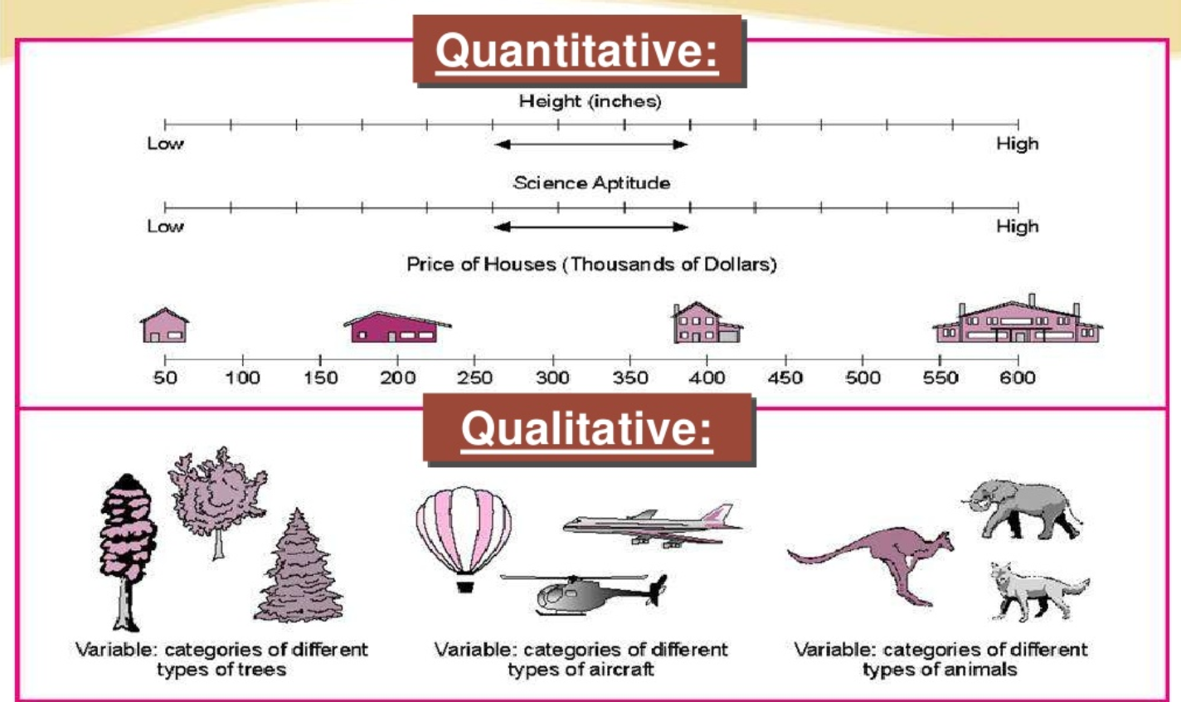

Slide 4
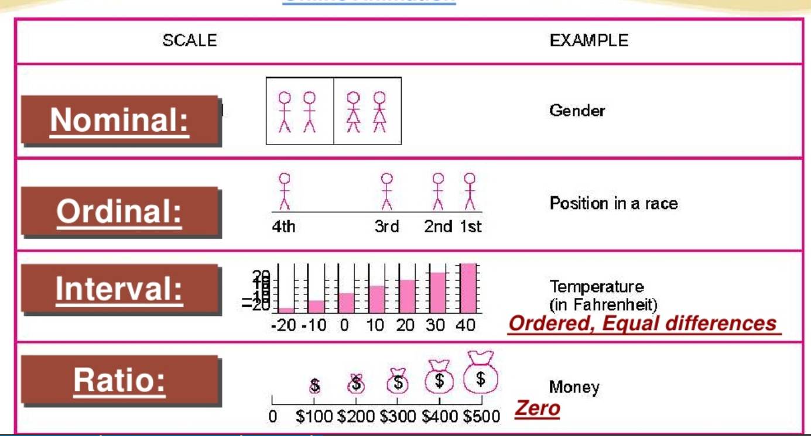

Slide 5
Mathematical Operations, Central tendency
Variable | Examples | Central Tendency/Mathematical Operations
Nominal | gender, nationality, ethnicity, language, genre, style, biological species | Set membership, classification, categorical equality, and equivalence Mode
Ordinal | 'completely agree', 'mostly agree', 'mostly disagree', 'completely disagree' | Median , Mode
Interval | Celsius, Date from arbitrary epoch | Mean, Median , Mode,…
Ratio | mass, length, duration, plane angle, energy and electric charge | +, Geometric Mean, Harmonic Mean

Slide 6
Ordinal Variable examples
Elementary school education
High school graduate
Some college
College graduate
Graduate degree

Slide 7
Types of variables
Age
Exercise
(Extraneous)
Smoking
(Independent)
Cancer
(Dependent)
Independent
Dependent
Extraneous
Intervening
Education
(Extraneous)
Mortality
(Independent)
Fertility
(Dependent)
Contraceptives
(Intervening)

Slide 8
Goodness of measure
Validity
  Degree to which an instrument measures what it is suppose to measure.
Reliability
  Measuring instrument is reliable if it provides consistent results.
  Reliable measuring instrument does contribute to validity, but valid instrument need not be a reliable instrument.

Slide 9
Q: Are the following Nominal , Ordinal, Interval or Ratio Data. Explain your answer
Temperatures measure on Kelvin Scale
Military ranks
Social security numbers
Number of passengers on buses from Delhi to Mumbai
Code number given to the religion of person

Slide 10
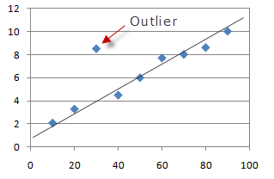
Data Preparation
Missing values and outliers

Slide 11
Data Preparation, Missing values and outliers
Replace the missing value by arithmetic mean
An observation with a value that is more than 3 standard deviations from the mean is considered as an outlier.
The researcher may like to delete it or modify the value of it or keep it as it is. It depends on the knowledge about the cause of the outlier.

